Slide 1
Committee of the Whole Presentation
Technology Advantage Program
November 27, 2019

Slide 2
Agenda:
Part 1: What is TAP?
Part 2: Water Issues In Yarmouth
    Water filling stations
    Algae blooms
    Litter
    Water Scarcity
Part 3: Coastline Safety App

Slide 3
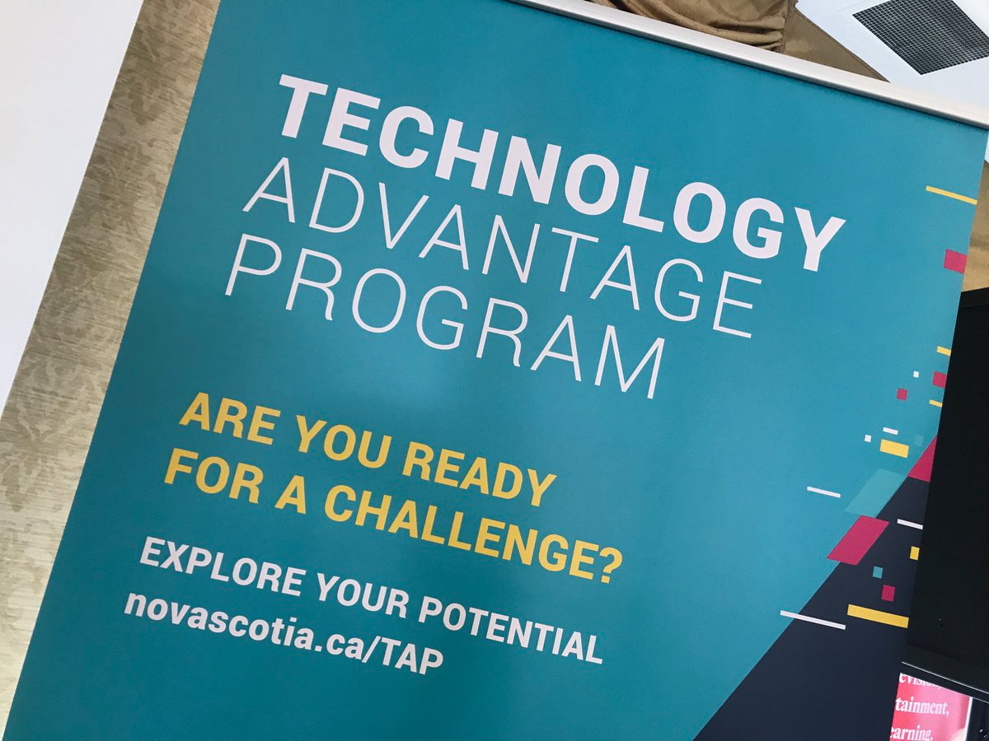
Part 1: What Is TAP?
Presented by:
Charlie McLaughlin
Glace Pritchard

Slide 4
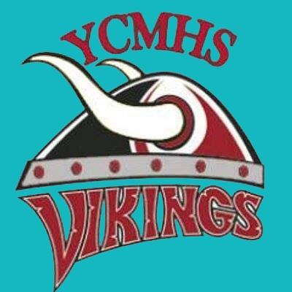
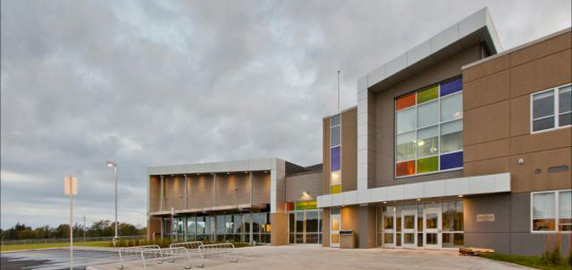

What Is TAP?
TAP stands for: Technology Advantage Program
It is a six-year program, at no cost to students
  Four years at YCMHS
  Two years at NSCC
Only offered in Nova Scotia
Only a small number of other schools around the province have the TAP program
YCMHS

Slide 5
How Is TAP Different From Other Programs In Nova Scotia?
We get to have the most contact with technology like our Chromebooks, building computers, 3D printers, servers, video taping, etc.
We get to go on field trips as part of our learning experience.
We do more group work instead of individual work.

Slide 6
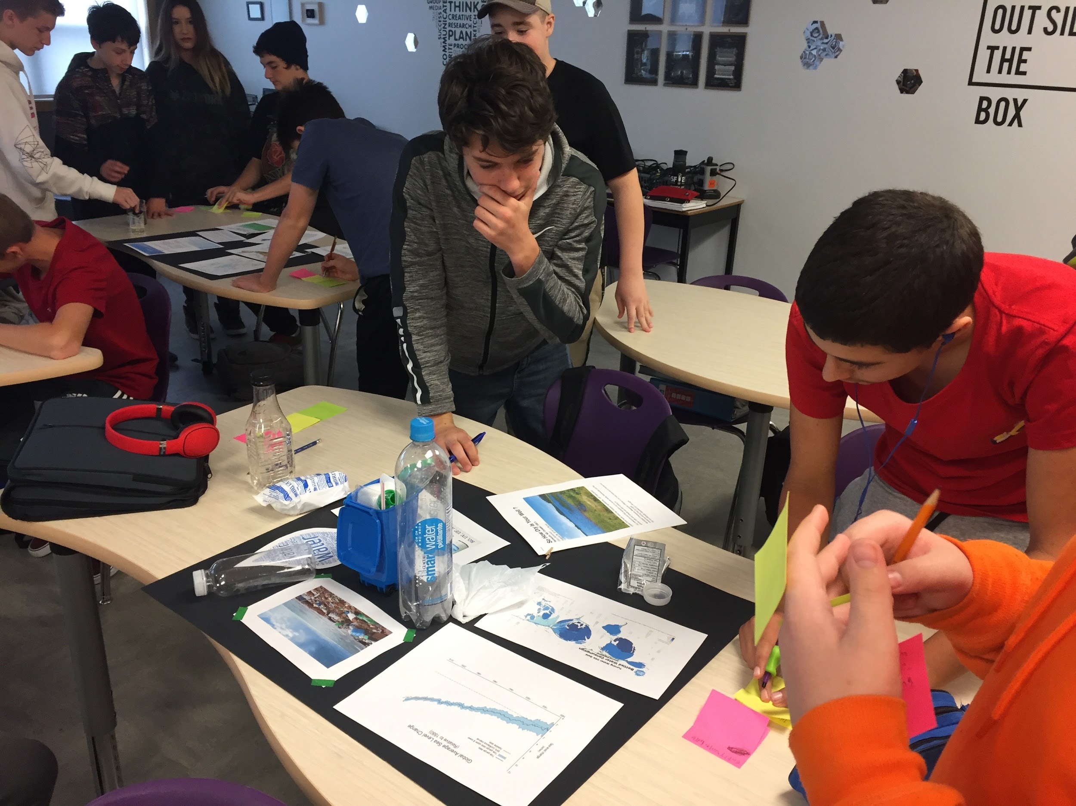
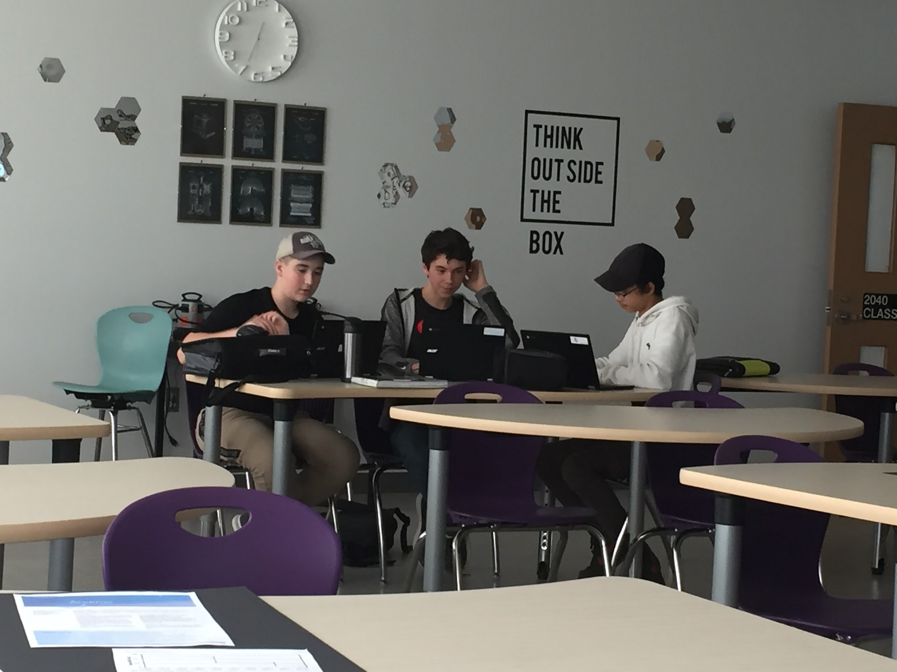
Project Based Learning
The TAP program follows a project based learning model, which means that researching and solving problems is what we do.
Hard at
work in
our class

Slide 7

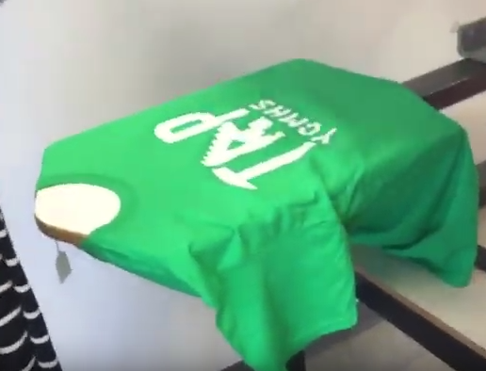
Projects We’ve Accomplished:
Logo Design
Shirt Design With The Logo
How Safe Is Our Water?
Finalized Logo
Screen Printing Onto Shirts

Slide 8
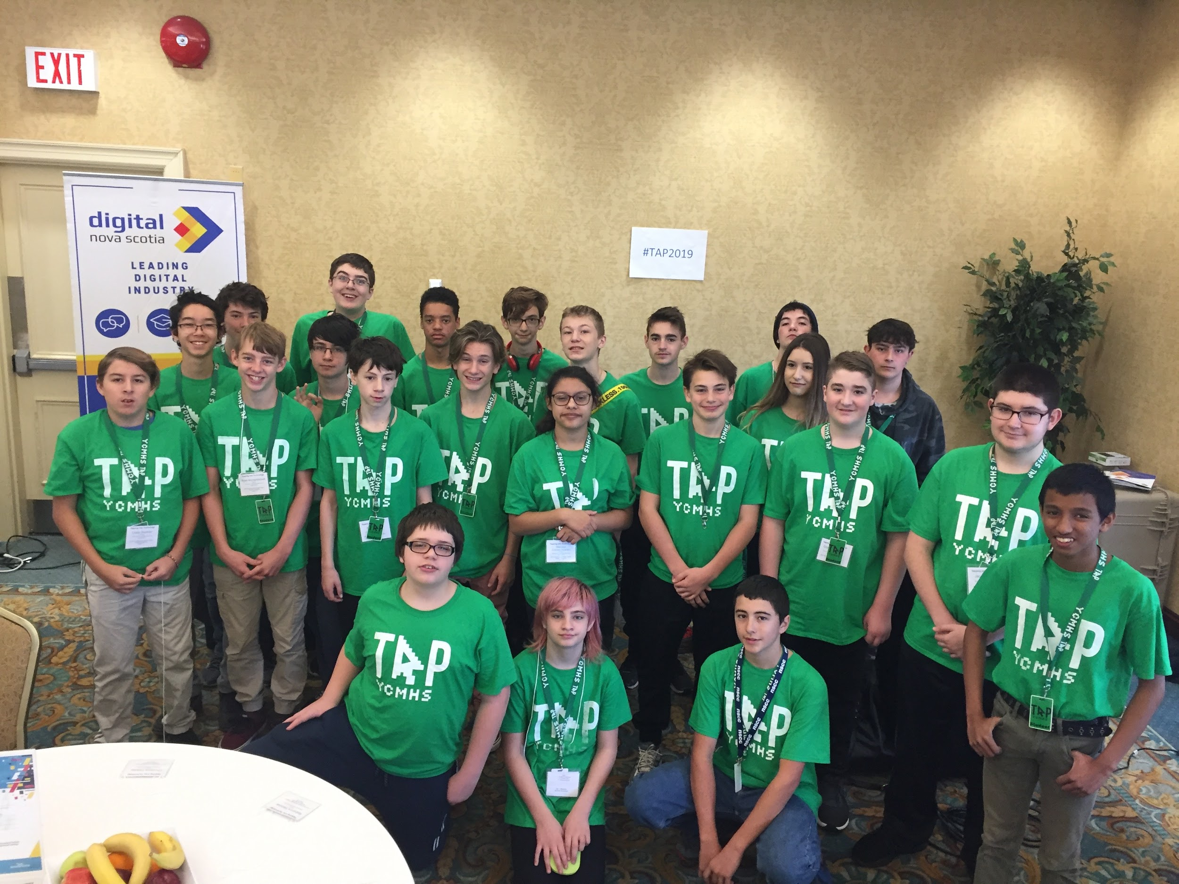
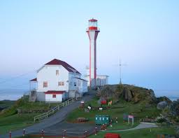
Field Trips:
TAP Conference
3 day trip to Halifax
  Revolve
  Hotel Halifax - TAP Conference
  Discovery Center
TCRCE Hebron Operations Centre
Web.com
Cape Forchu Light Station
Mariners Centre - MC Media
Cape Forchu Light Station

Slide 9

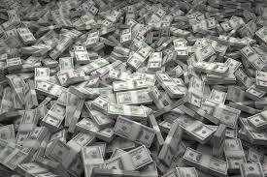
What Are the Benefits of TAP?
A free technology diploma in an IT strand
Opportunities for jobs that make really good salaries
A lot of hands on experience in the workplace
We are building relationships with different IT partners

Slide 10
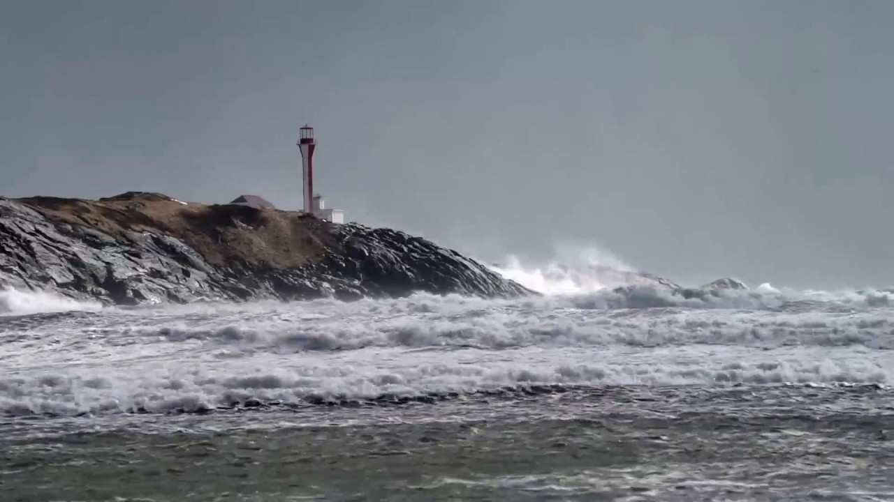
Part 2: Water Issues in Yarmouth
Cape Forchu
Light Station
Presented by:
Xander Barry
Josh Baltzer

Slide 11
How Safe is our Water?
We’re working on the broad topic, “How Safe is our Water?”
We thought of some ways our water is either disrupted or polluted
Our thinking led us down several paths towards fixing our polluted or disrupted water sources:
  Water filling stations
  Algae blooms
  Litter
  Water Scarcity
  Coastline safety (Our main topic of focus which will be
covered in the third section.)

Slide 12
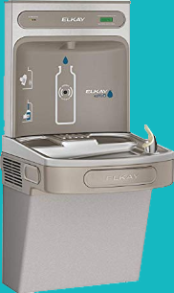
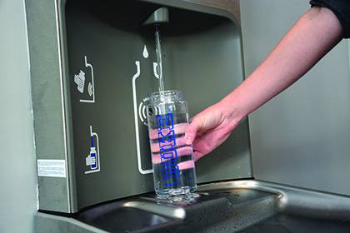
Water Filling Stations
As society becomes more physically active and more tourists visit, larger towns and cities have added water filling stations to their infrastructure to support physically active lifestyles.
This allows people to fill reusable bottles with clean drinking water while they are on-the-go.

Slide 13
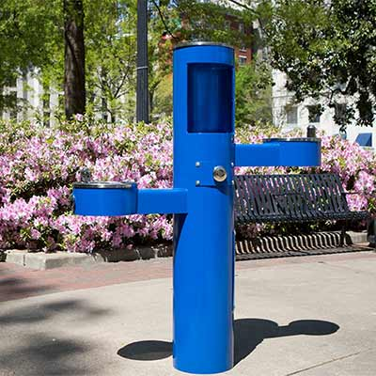
Water Filling Stations - Continued
We believe we could support physically active lifestyles by placing water stations on some of the buildings downtown, on running trails and other tourist attractions.

Slide 14
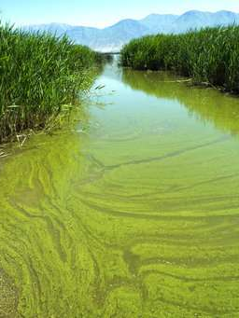
Algae Blooms
Algae blooms use up oxygen in the water causing a die off in fish and aquatic life.
Algae blooms are caused by high levels of nutrients, sunlight, and agriculture.
Link

Slide 15
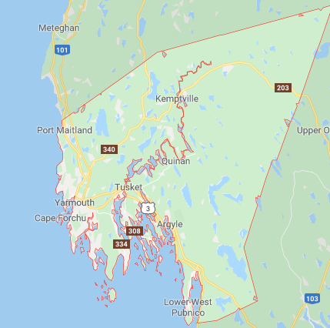
Lake Parr, Forest Glen
Lake Ogden, Forest Glen
Lake Fanning, Carlton 2008-2009
Legend
Past algae blooms

Slide 16
Litter Problems
Litter destroys ecosystems, animal habitats, and contaminates water.
To fix this problem, we could hire students to pick up trash.
We know this could work because the O2 Program at YCMHS has picked up a total of 23,773 Ibs of garbage around Yarmouth voluntarily.

Slide 17
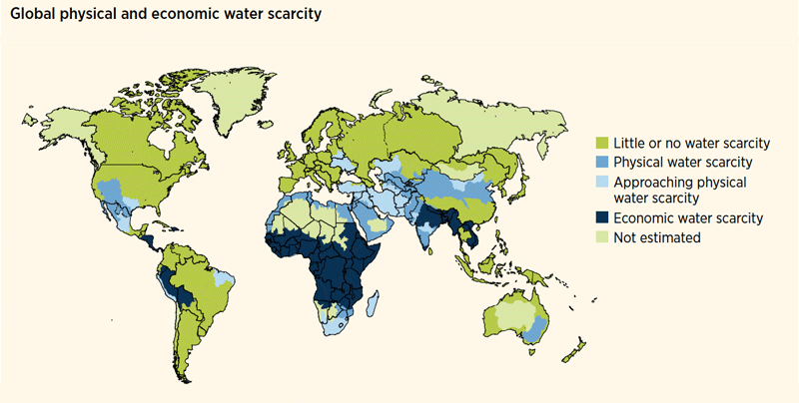
Water Scarcity
In Nova Scotia, we’re lucky that we don't need to worry about the scarcity of water.
However, the drought conditions of summer 2016, and the lack of rain this past summer are becoming major concerns.

Slide 18
Water Scarcity - Continued
We could add a big filter station that filters the water from the ocean before it goes near Yarmouth. It would cost millions but the effect of it would last for years.
There is an option for desalination of water. The desalination of water is the process of boiling salty water so that the salt is removed and the result is fresh water.

Slide 19
Water Scarcity - Continued
Another option is to purchase LifeStraws for all residents
LifeStraws filter 99.99% of bacteria and salt out of water
LifeStraw filters can be cleaned for multiple uses and used for multiple water types
For every LifeStraw sold, the company will build wells in places like Africa that experience water scarcity
Notes:
Lifestraw

Slide 20

Part 3: Coastline Safety App
Presented by:
Cameron Brown
Jayden Marshall

Slide 21
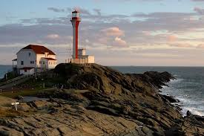
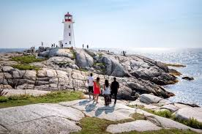
The Problem/Issue:
Locals and tourists are getting injured at popular tourist locations around the coast.
Cape Forchu Light Station
Peggy’s Cove Lighthouse

Slide 22
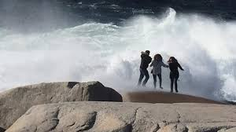
How It Affects Locals And Tourists:
Tourist and locals are getting injured from Nova Scotia’s rugged coastline.
When people fall into the water or slip on the rocks, it’s very hard to help them because of the terrain.
With that in mind, we want to ensure the safety of the locals and tourists along our coastlines.
Peggy’s Cove

Slide 23
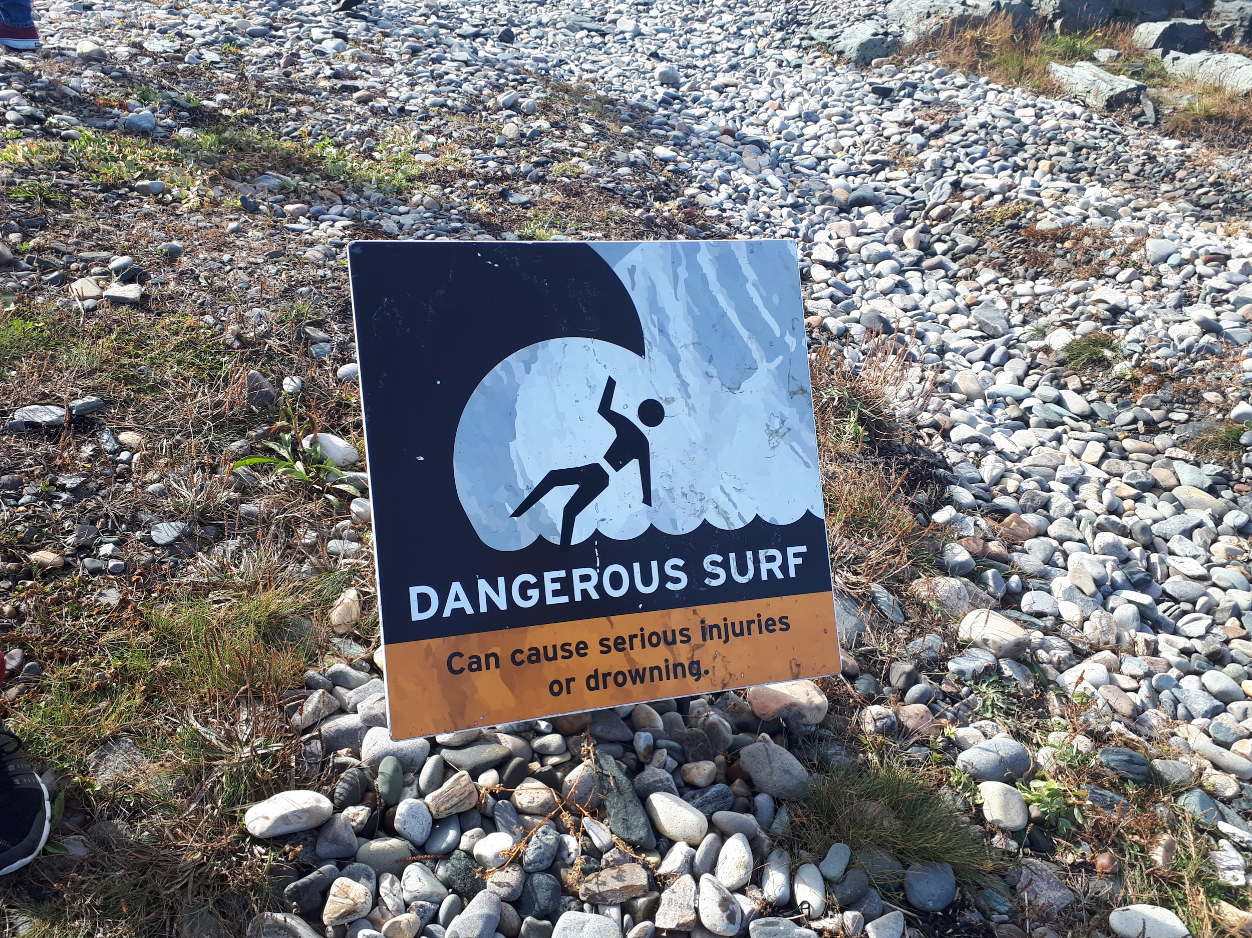
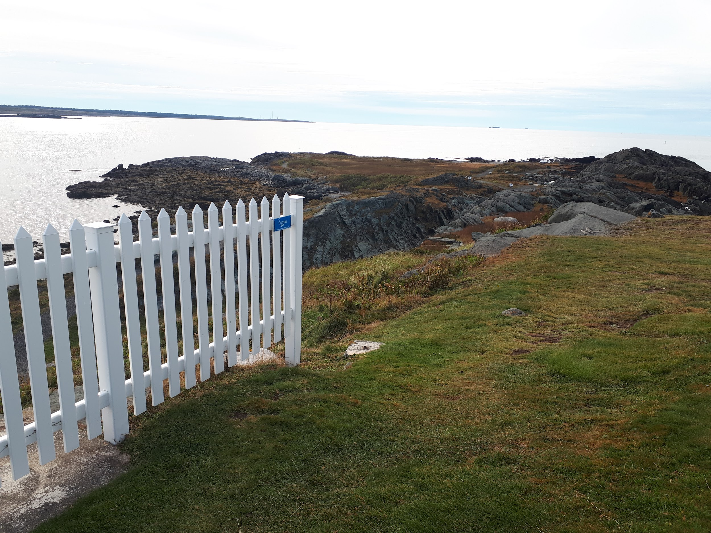
Cape Forchu Safety Survey:
As a class, we went to the Cape Forchu Light Station to survey and collect data about the area.
We as a class, found there aren’t many warning signs.
Therefore, we feel visitors and tourists to our rough coastlines need to be more mindful of potential dangers at our light station and others around the province.
Small Warning Sign,
Cape Forchu
Fencing Cutting Off, Leaving Part of The Cliff Open

Slide 24
Our Idea & Solution:
We think we could use geofencing.
Geofencing is the use of GPS technology to create a virtual geographic boundary around the perimeter of certain areas.
We could then place Bluetooth-based computer chips in rocks around dangerous, specific areas at Cape Forchu and/or Peggy’s Cove.
As people cross dangerous areas, a notification will be sent through the embedded computer chips to GPS satellites that will send alerts/notifications to your phone.

Slide 25
Our Idea & Solution - Continued:
To advertise this app, we will put ads on government websites, social media pages and signs at the light station to intrigue people into getting this app.
We also think we could link other tourist attractions through our app to advertise.
We as a community are extremely lucky to have such a great tourist destination being the light station and it, being in such a beautiful setting.

Slide 26
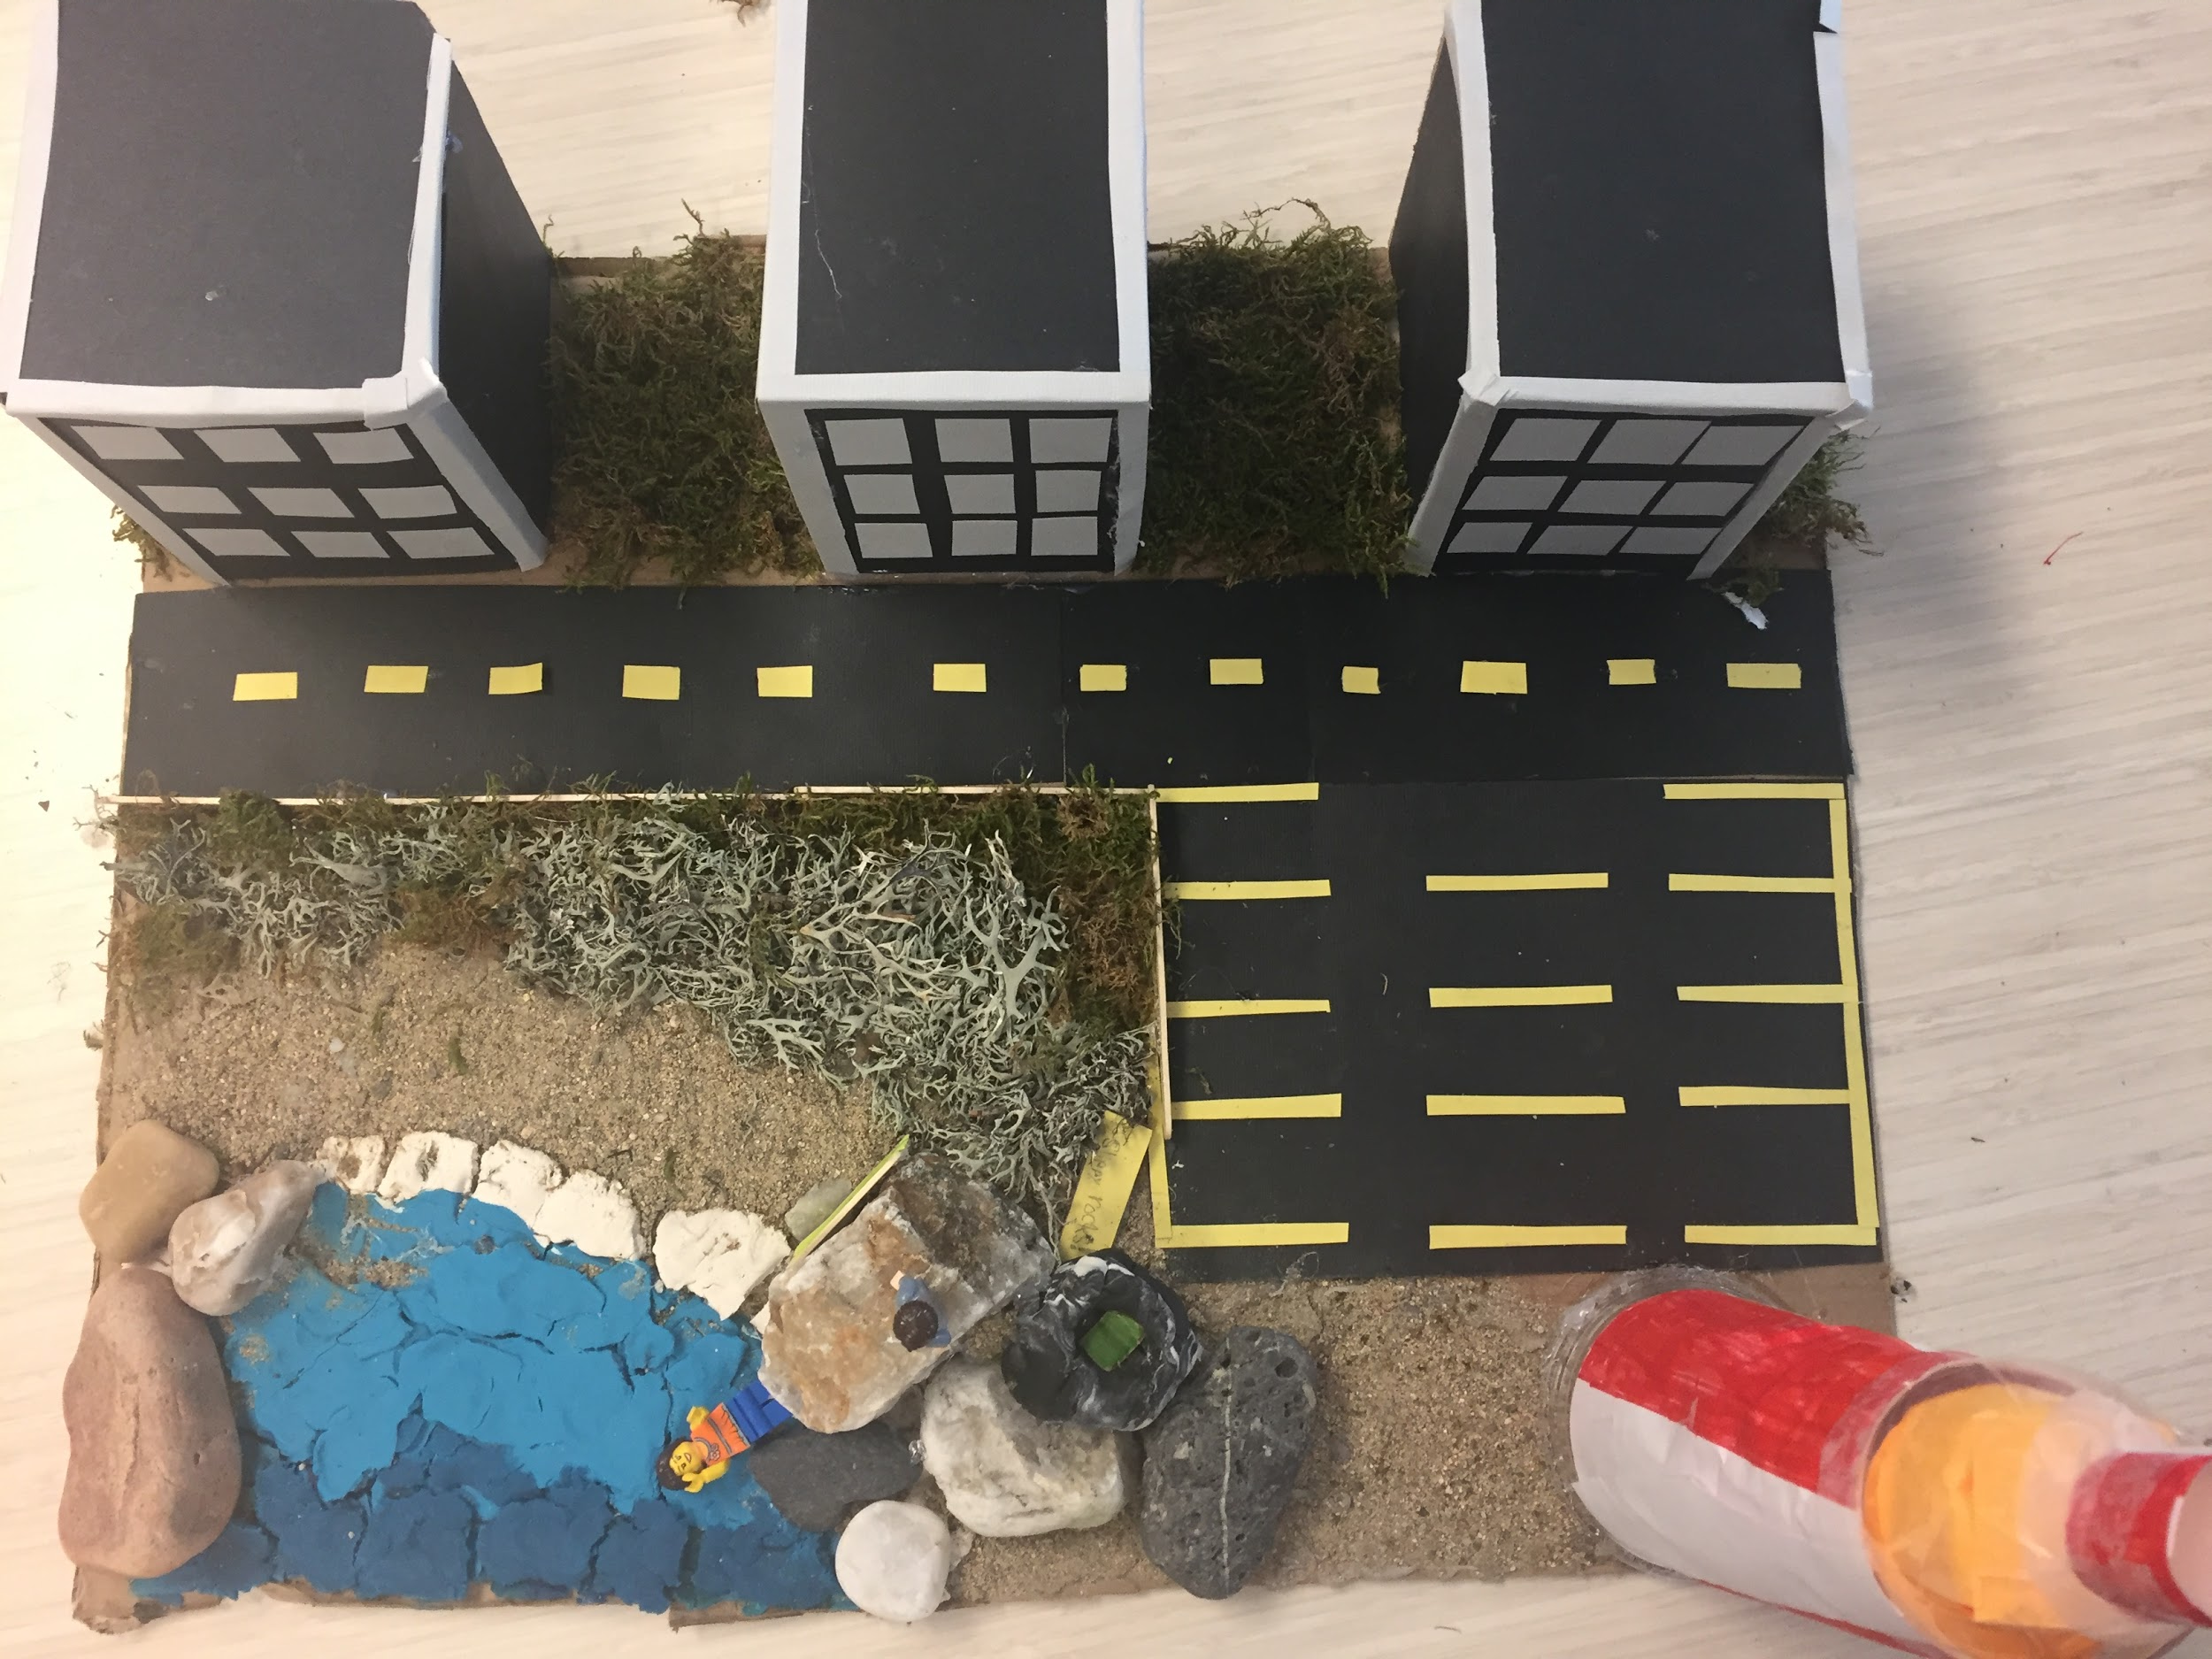
The Model:
Rock with implemented chip, creating a virtual boundary.

Slide 27
Thank you for listening to our project and for inviting us to present.
Questions?

